Slide 1
HCPSS – RO Portal
20220617

Slide 2
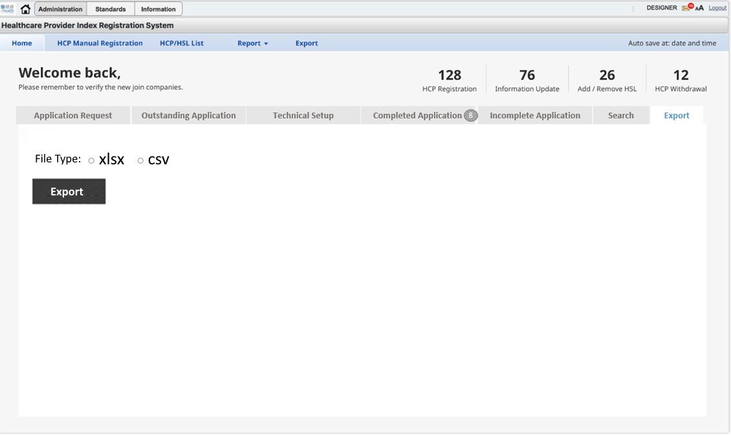
Export Function Page

Slide 3
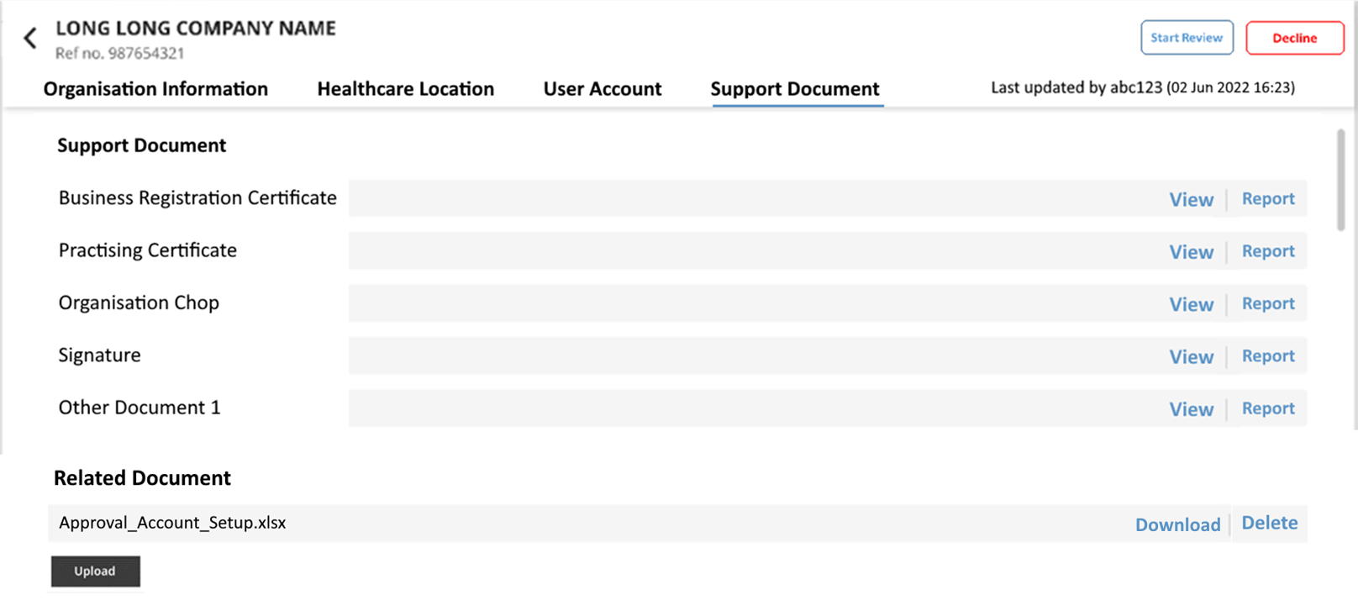
Support Document

Slide 4
Thank you

